Slide 1
Classifier: Decision Tree

Slide 2
Classification: Definition
Given a collection of records (training set)
Each record is by characterized by a tuple (X,y), where X is the attribute set and y is the class label
X: attribute, predictor, independent variable, input
y: class, response, dependent variable, output
Task:
Learn a model that maps each attribute set x into one of the predefined class labels y
Decision Tree
Robust to noisy and missing data
less effort for data preparation during pre-processing
very intuitive and easy to explain to technical teams as well as stakeholders
Ensemble models are constructed from Decision Tree

Slide 3
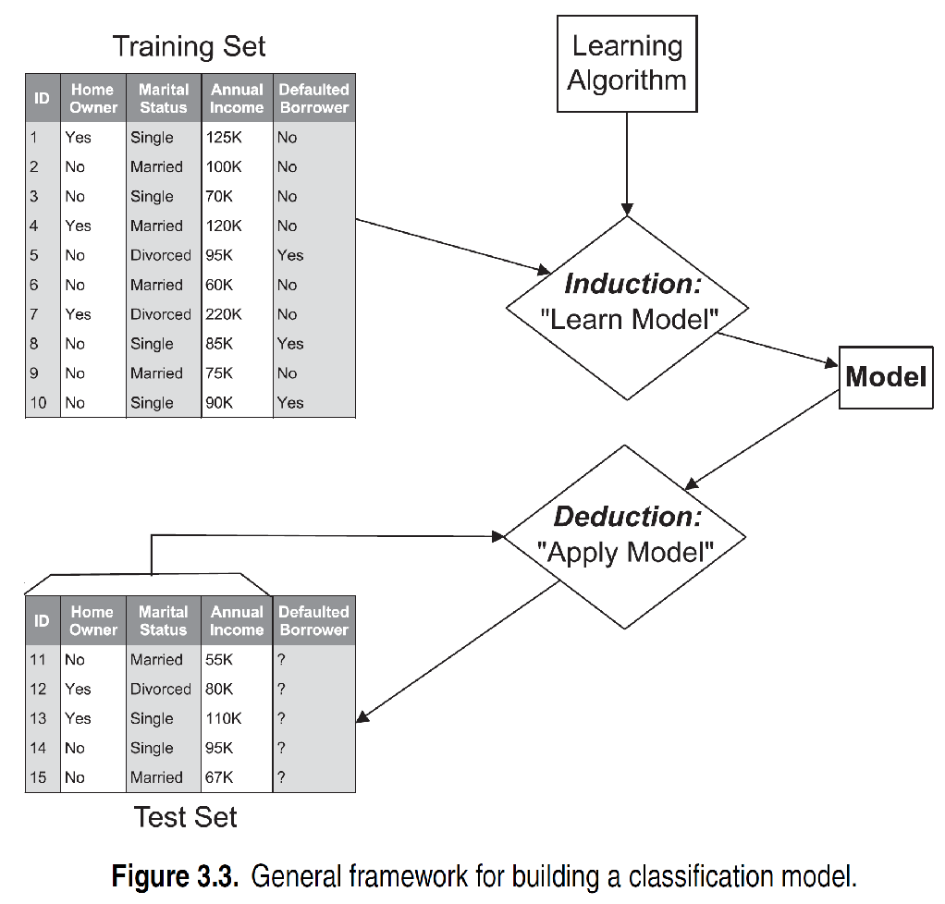
General Approach for Building Classification Model
Induction: Learn from examples (training process)
Deduction/Inference: Predict from the trained model (testing process)

Slide 4
Classification Techniques
Base Classifiers
OneR and ZeroR
Decision Tree based Methods
Rule-based Methods
Nearest-neighbor
Naïve Bayes and Bayesian Belief Networks
Support Vector Machines
Neural Networks, Deep Neural Nets
Ensemble Classifiers
Boosting, Bagging, Random Forests

Slide 5
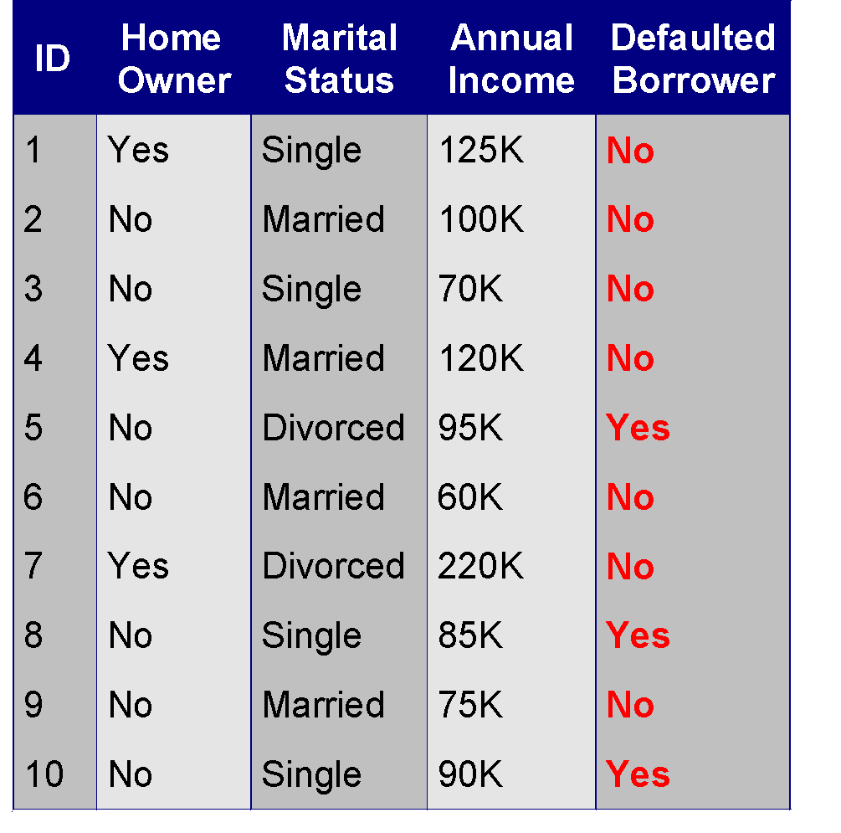
Example of a Decision Tree
Home owner: Root/Parent node: from where the decision tree starts
Yes/No: Leaf node: final output node
Income/marital status: Branch node: tree formed by splitting the tree
Pruning: removing the unwanted branches from the tree
categorical
categorical
continuous
class
Splitting Attributes
Home Owner
Yes
No
NO
MarSt
Single, Divorced
Married
Income
NO
< 80K
> 80K
NO
YES
Training Data
Transforms the data into a tree representation. Each internal node of the tree representation denotes an attribute, and each leaf node denotes a class label

Slide 6
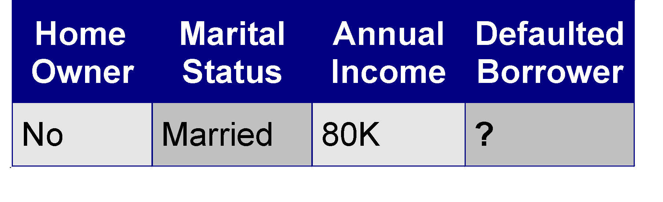
Apply Model to Test Data
Test Data
Start from the root of tree.
Home Owner
Yes
No
NO
MarSt
Single, Divorced
Married
Income
NO
< 80K
> 80K
NO
YES

Slide 7

Another Example of Decision Tree: Same Training dataset
categorical
categorical
continuous
class
Single, Divorced
MarSt
Married
NO
Home Owner
Yes
No
NO
Income
< 80K
> 80K
NO
YES
There could be more than one tree that fits the same data!

Slide 8
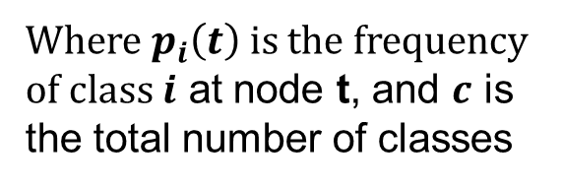
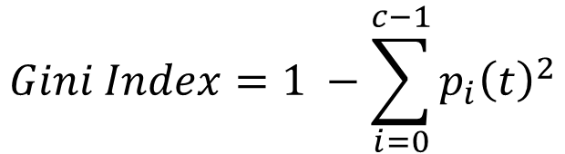
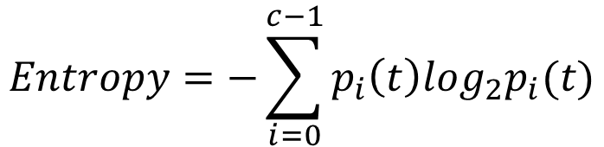
Measures of Node Impurity
Gini Index
Entropy
Misclassification error

Slide 9
Example of a Decision Tree
HO
Yes
categorical
categorical
continuous
No
class
Yes:0 No:3
Yes:3 No:4
GI (Yes) = 0; GI (No) = 0.489
Weighted GI = 0*3/10 + 0.489*7/10= 0.34
MS
S
D
M
Yes:2 No:2
Yes:0 No:4
Yes:1 No:1
GI (S) = 0.5; GI (M) = 0; GI (D) = 0.5
Weighted GI = 0.5*4/10 + 0*4/10+.5*2/10= 0.3: MS is the root/parent node

Slide 10
Decision Tree Hyperparameters sklearn
sklearn.tree.DecisionTreeClassifier
class sklearn.tree.DecisionTreeClassifier(*, criterion='gini', splitter='best', max_depth=None, min_samples_split=2, min_samples_leaf=1, min_weight_fraction_leaf=0.0, max_features=None, random_state=None, max_leaf_nodes=None, min_impurity_decrease=0.0, class_weight=None, ccp_alpha=0.0)
1. max_depthint, default=None
The maximum depth of the tree. If None, then nodes are expanded until all leaves are pure
2. min_samples_splitint or float, default=2
The minimum number of samples required to split an internal node
3. min_samples_leafint or float, default=1
The minimum number of samples required to be at a leaf node
4. max_featuresint, float or {“auto”, “sqrt”, “log2”}, default=None
The number of features to consider when looking for the best split

Slide 11
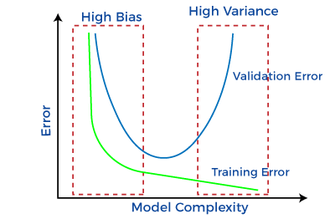
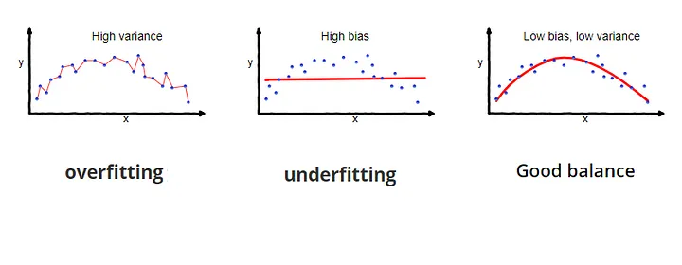
Bias and Variance
Bias: Error rate of the training data. When the training error rate has a high value, we call it High Bias and when the error rate has a low value, we call it low Bias.
Variance: Error rate of the test data.
Usually, we want to make low bias and low variance for generalized our model
Goal: Generalized/appropriate-fitting model with low bias and low variance

Slide 12
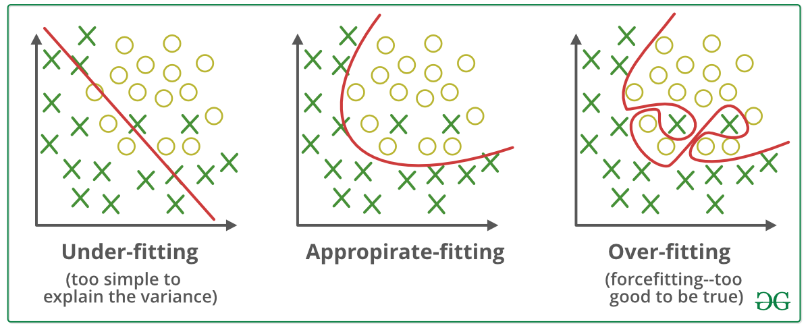
Overfit and Underfit
Underfit: Underfitting refers to a model that can neither performs well on the training data nor generalize to new test data. The size of the training dataset used is not enough. The model is too simple
Overfit: Refers to a model that models the training data too well. Overfitting happens when a model learns the detail and noise in the training data to the extent that it negatively impacts the performance of the model on new test data

Slide 13
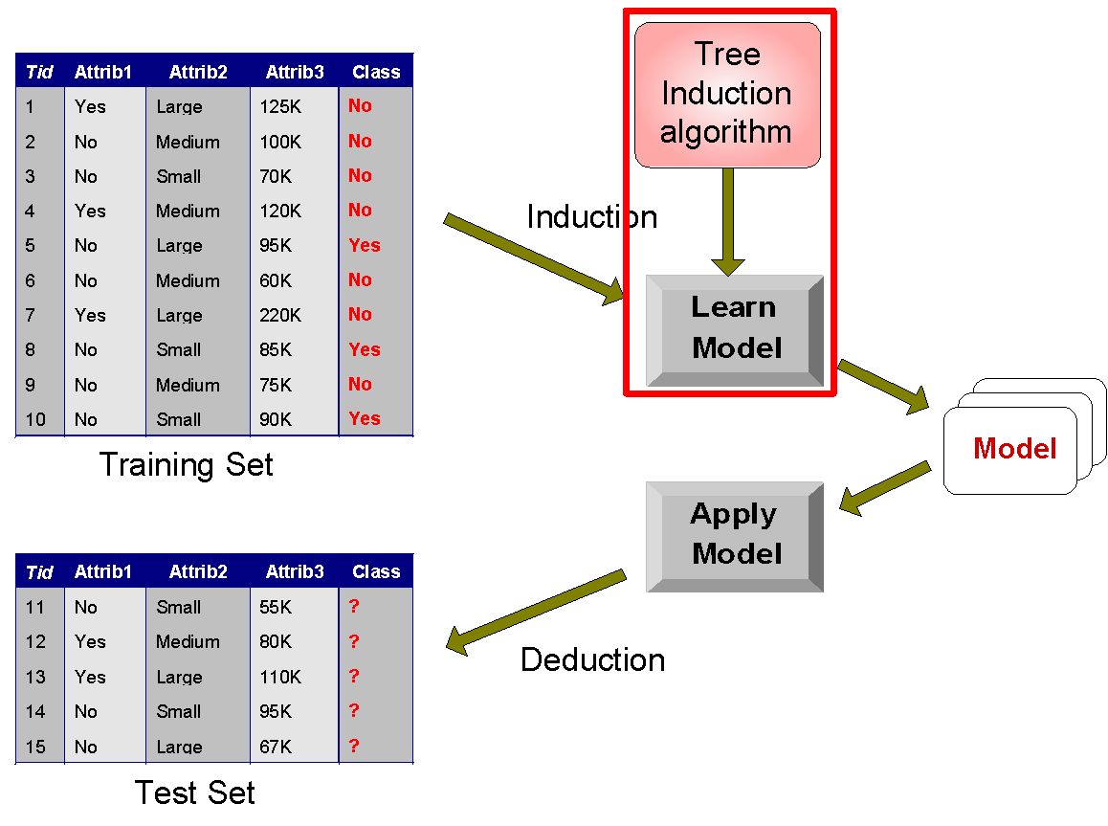
Decision Tree Classification Task
Decision Tree

Slide 14
Decision Tree Induction
Many Algorithms:
Hunt’s Algorithm (one of the earliest)
CART (Classification and Regression Trees)
ID3, C4.5
SLIQ,SPRINT

Slide 15
General Structure of Hunt’s Algorithm
Let D_{t} be the set of training records that reach a node t
General Procedure:
If D_{t} contains records that belong the same class y_{t}, then t is a leaf node labeled as y_{t}
If D_{t} contains records that belong to more than one class, use an attribute test to split the data into smaller subsets. Recursively apply the procedure to each subset.
D_{t}
?

Slide 16
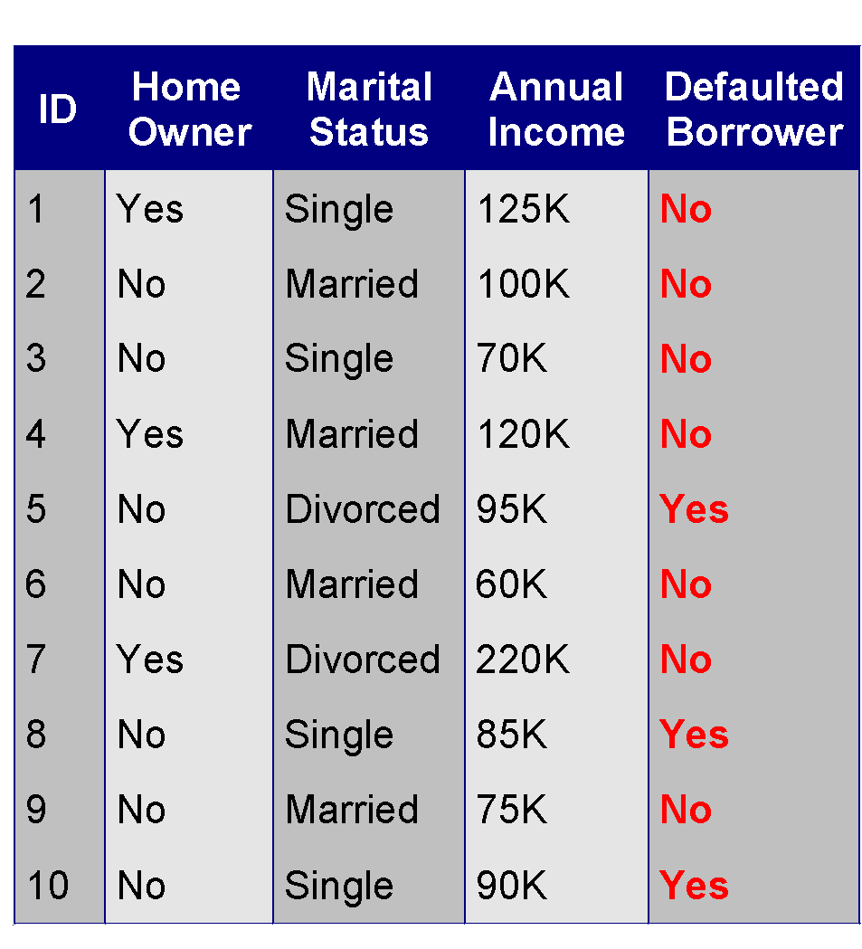
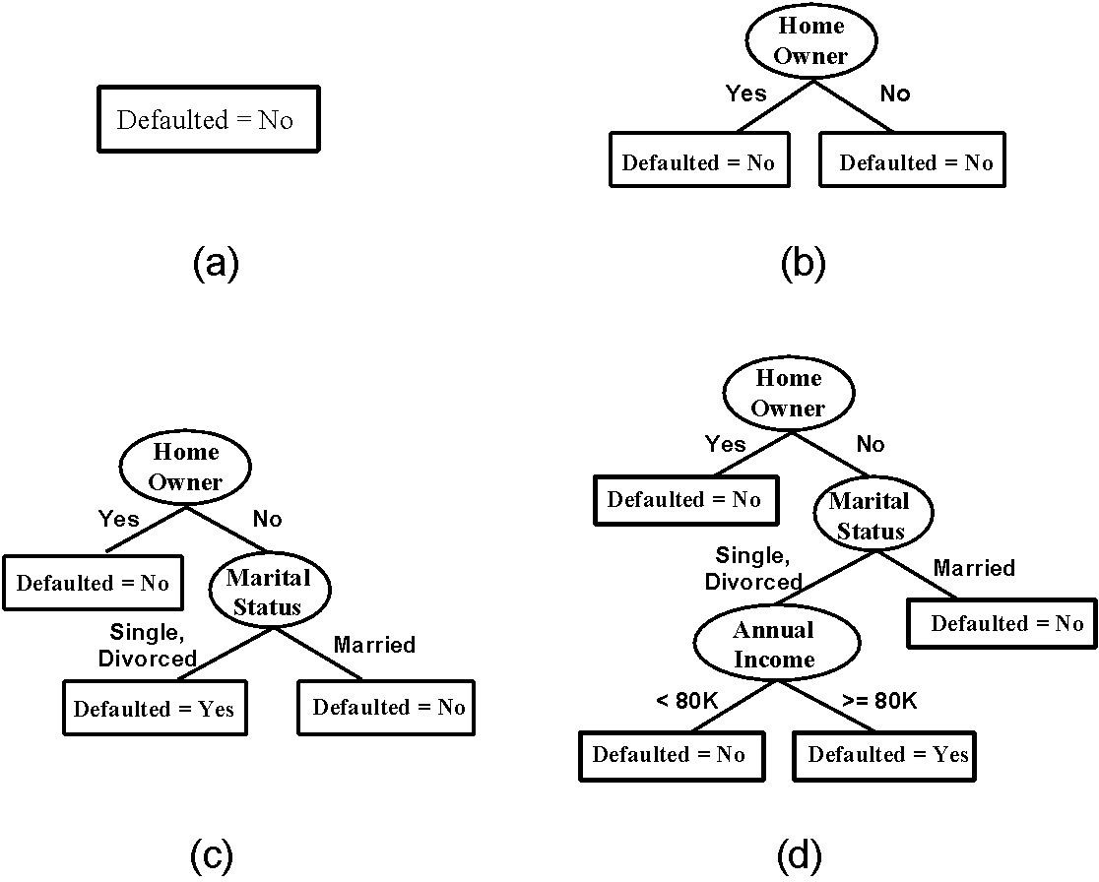
Hunt’s Algorithm
(7,3)
(3,0)
(4,3)
(3,0)
(3,0)
(3,0)
(1,3)
(3,0)
(1,0)
(0,3)

Slide 17
Hunt’s Algorithm
(7,3)
(3,0)
(4,3)
(3,0)
(3,0)
(3,0)
(1,3)
(3,0)
(1,0)
(0,3)

Slide 18
Hunt’s Algorithm
(7,3)
(3,0)
(4,3)
(3,0)
(3,0)
(3,0)
(1,3)
(3,0)
(1,0)
(0,3)

Slide 19
Hunt’s Algorithm
(7,3)
(3,0)
(4,3)
(3,0)
(3,0)
(3,0)
(1,3)
(3,0)
(1,0)
(0,3)

Slide 20
Design Issues of Decision Tree Induction
1. How should training records be split?
Method for expressing test condition
depending on attribute types
Measure for evaluating the goodness of a test condition
2. How should the splitting procedure stop?
Stop splitting if all the records belong to the same class or have identical attribute values or homogeneity achieved
Early termination

Slide 21
Methods for Expressing Test Conditions
Splitting depends on attribute types
Binary
Nominal: no orders
Ordinal: have orders
Continuous/numeric

Slide 22
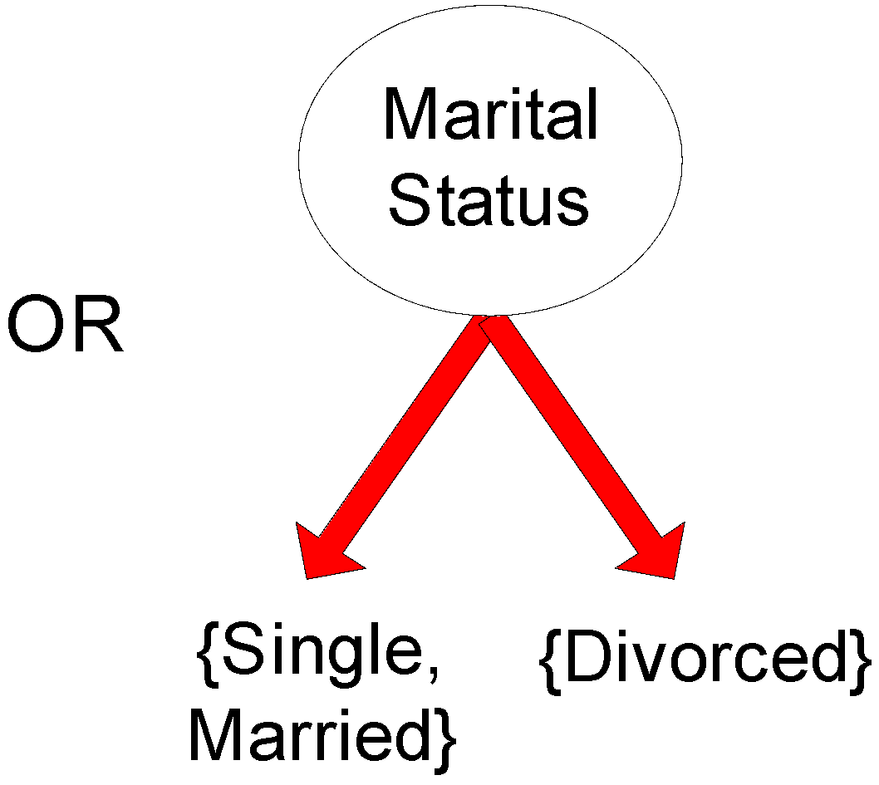
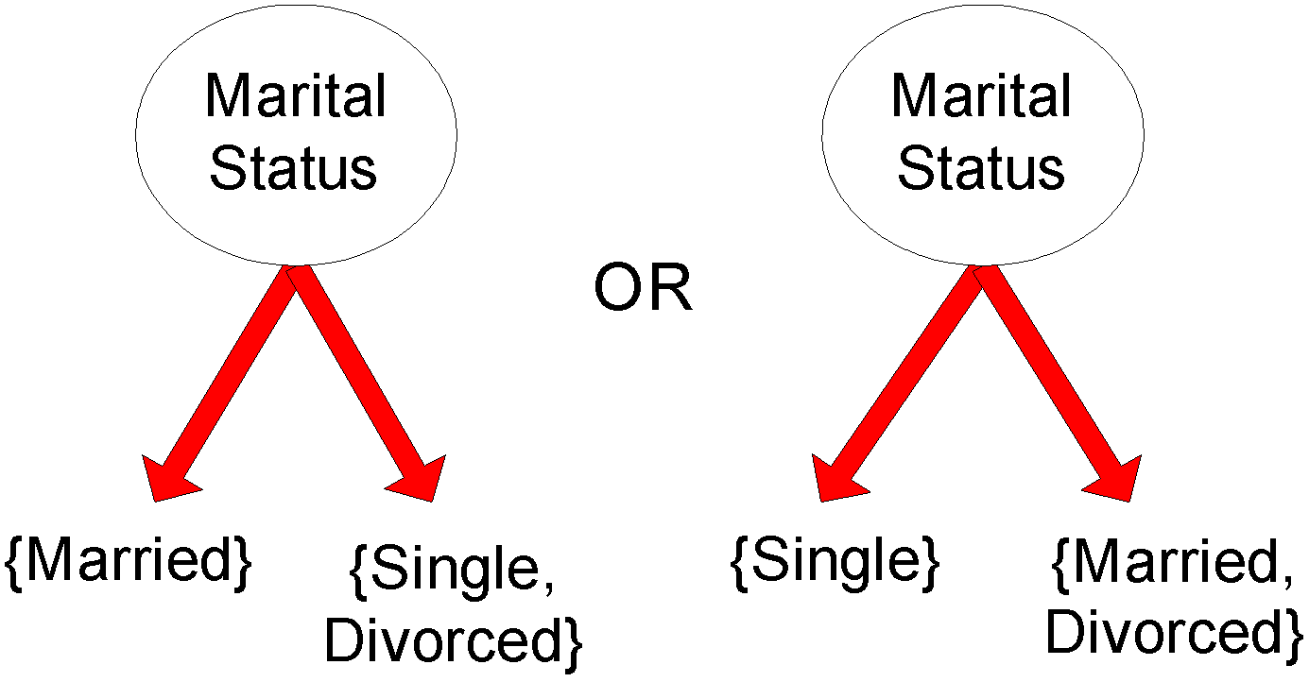
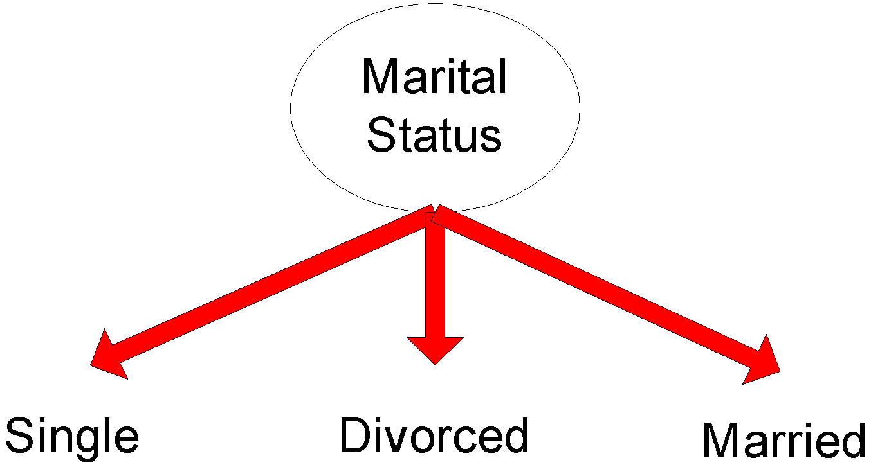
Test Condition for Nominal Attributes
Multi-way split:
Use as many partitions as distinct values.
Binary split:
Divides values into two subsets
Depends on Impurity Index

Slide 23
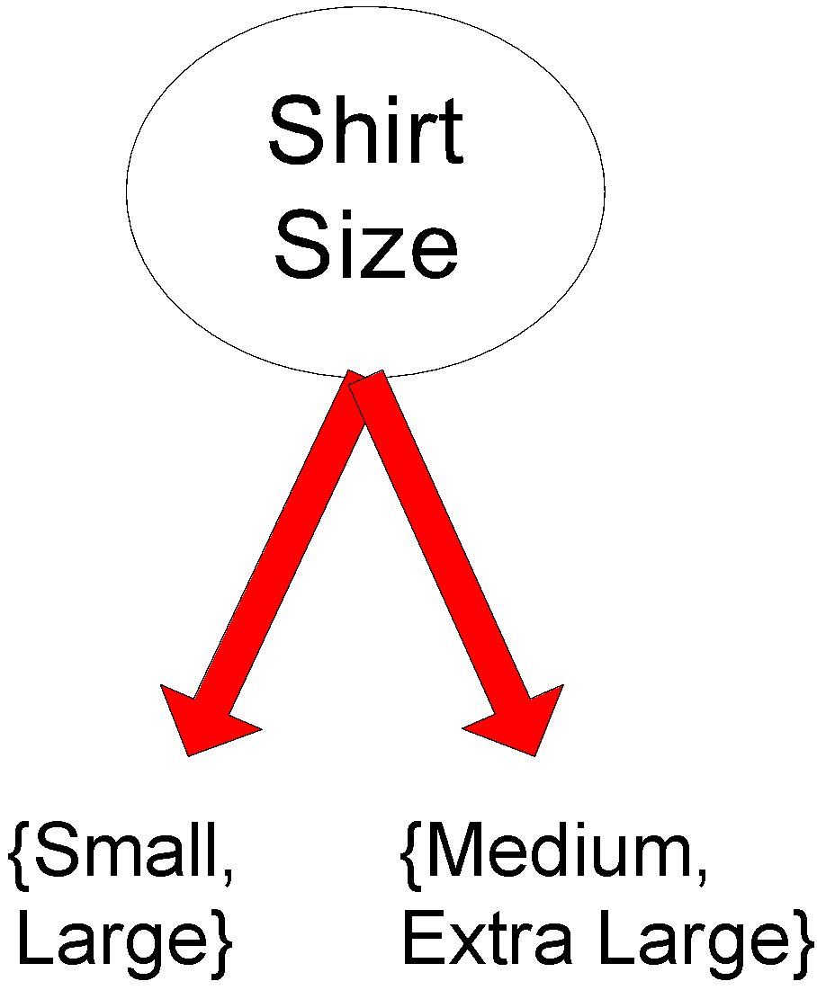
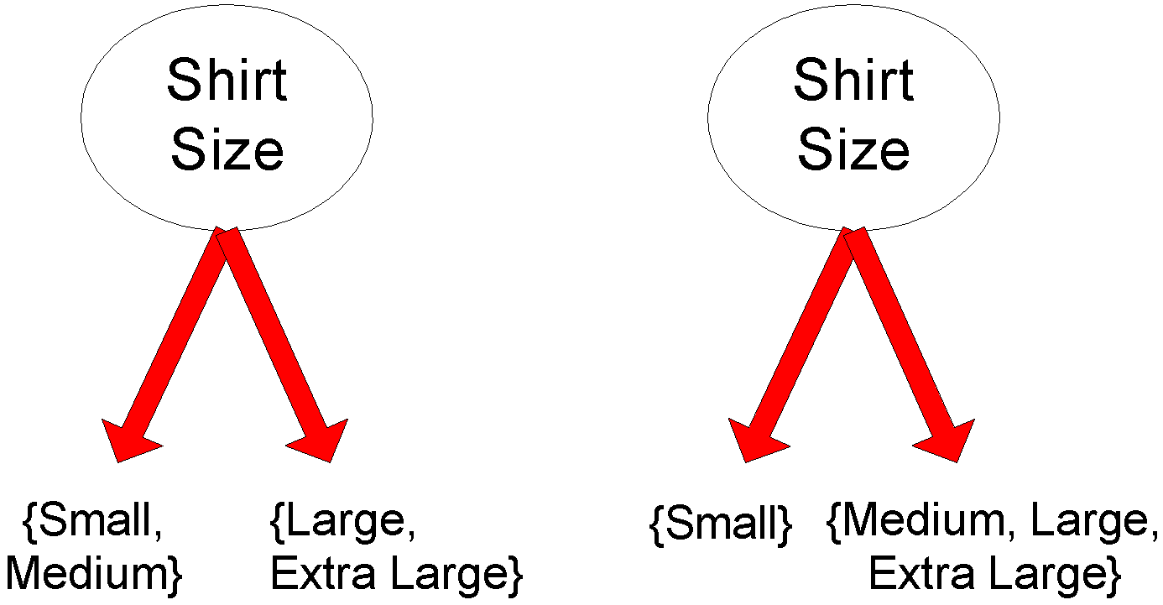
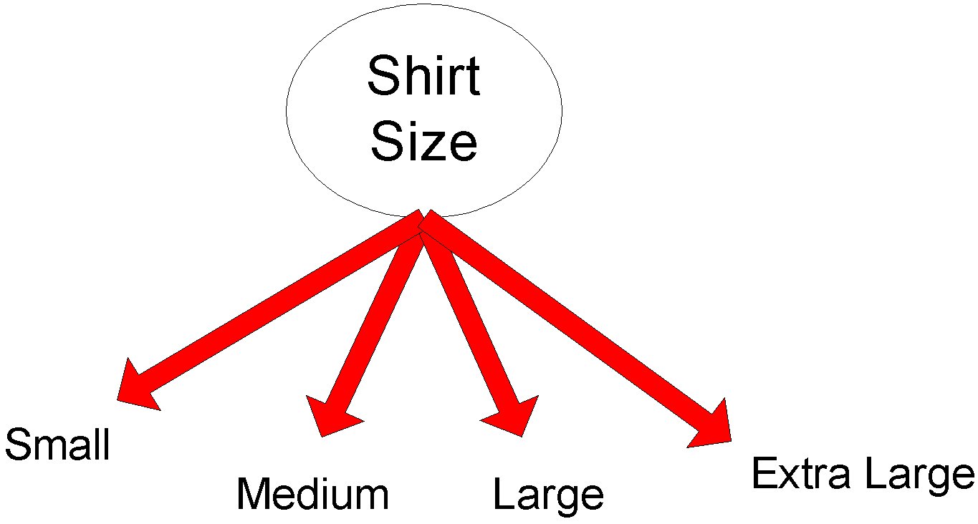
Test Condition for Ordinal Attributes
Multi-way split:
Use as many partitions as distinct values
Binary split:
Divides values into two subsets
Preserve order property among attribute values
This grouping violates order property
Wrong Splitting

Slide 24
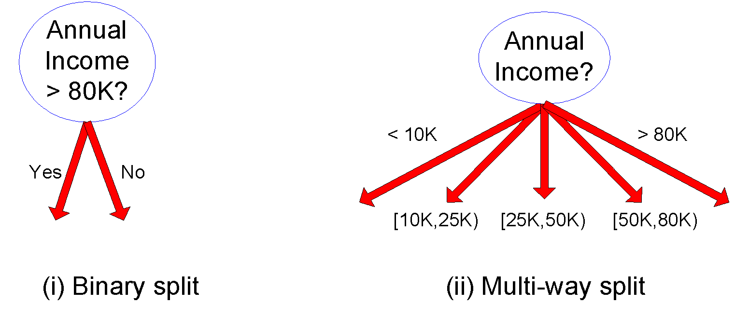
Test Condition for Continuous Attributes

Slide 25
Splitting Based on Continuous Attributes
Different ways of handling
Discretization to form an ordinal categorical attribute
Ranges can be found by equal interval bucketing, equal frequency bucketing (percentiles), or clustering.
Static – discretize once at the beginning
Dynamic – repeat at each node
Binary Decision: (A < v) or (A ≥ v)
consider all possible splits and finds the best cut
can be more compute intensive

Slide 26
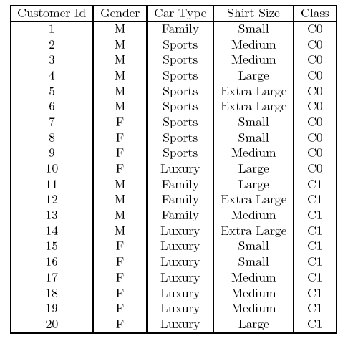
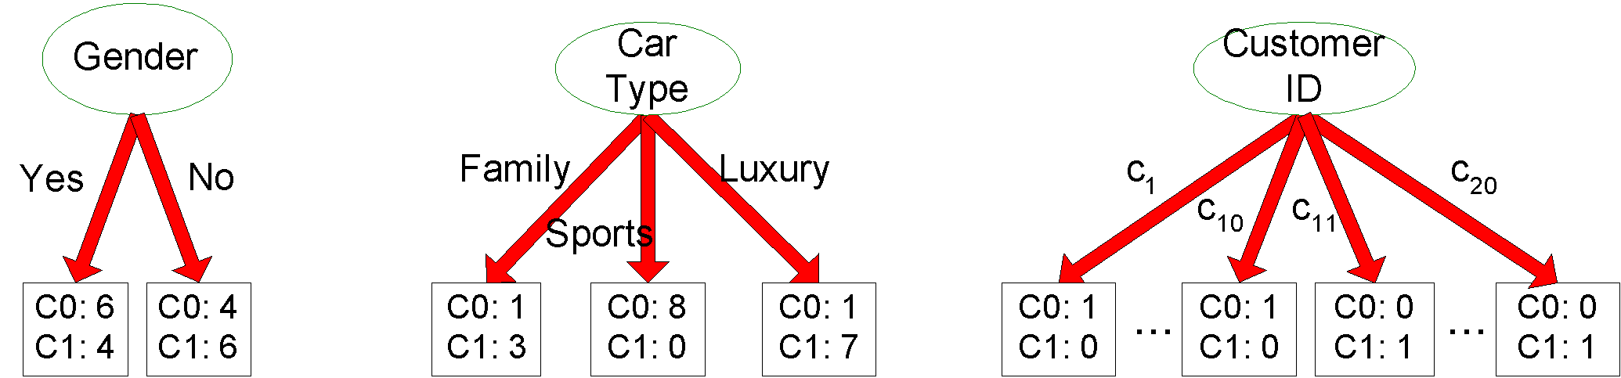
How to determine the Best Split
Before Splitting: 10 records of class 0, 10 records of class 1
Purpose of splitting: Make homogeneous/pure groups
Which test condition is the best?

Slide 27
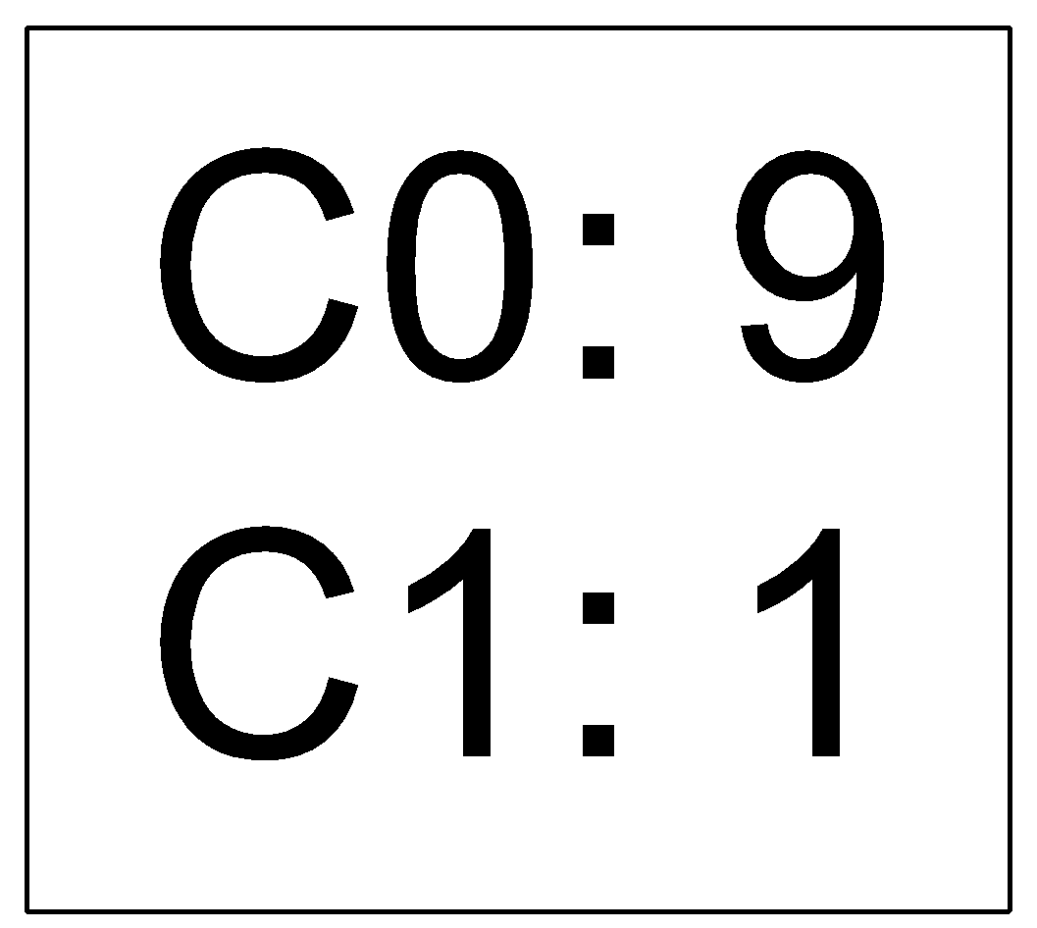
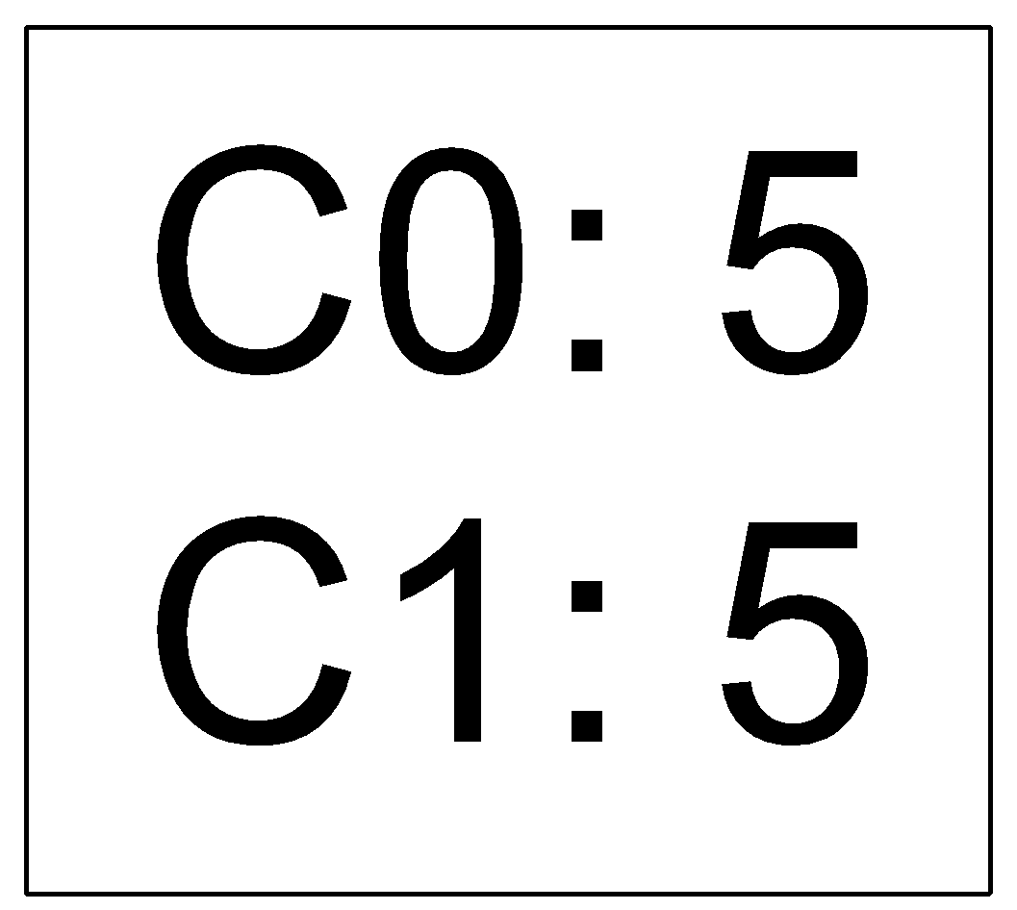
How to determine the Best Split
Greedy approach: approach for solving a problem by selecting the best option available at the moment
Nodes with purer class distribution are preferred
Need a measure/metric of node impurity
High degree of impurity
Low degree of homogeneity
Low degree of impurity
High degree of homogeneity

Slide 28
Measures of Node Impurity
Gini Index
Entropy
Misclassification error

Slide 29
Finding the Best Split
Compute impurity measure (P) before splitting
Compute impurity measure (M) after splitting
Compute impurity measure of each child node
M is the weighted impurity of child nodes
Choose the attribute test condition that produces the highest gain
Gain = P - M or equivalently, lowest impurity measure after splitting (M)

Slide 30
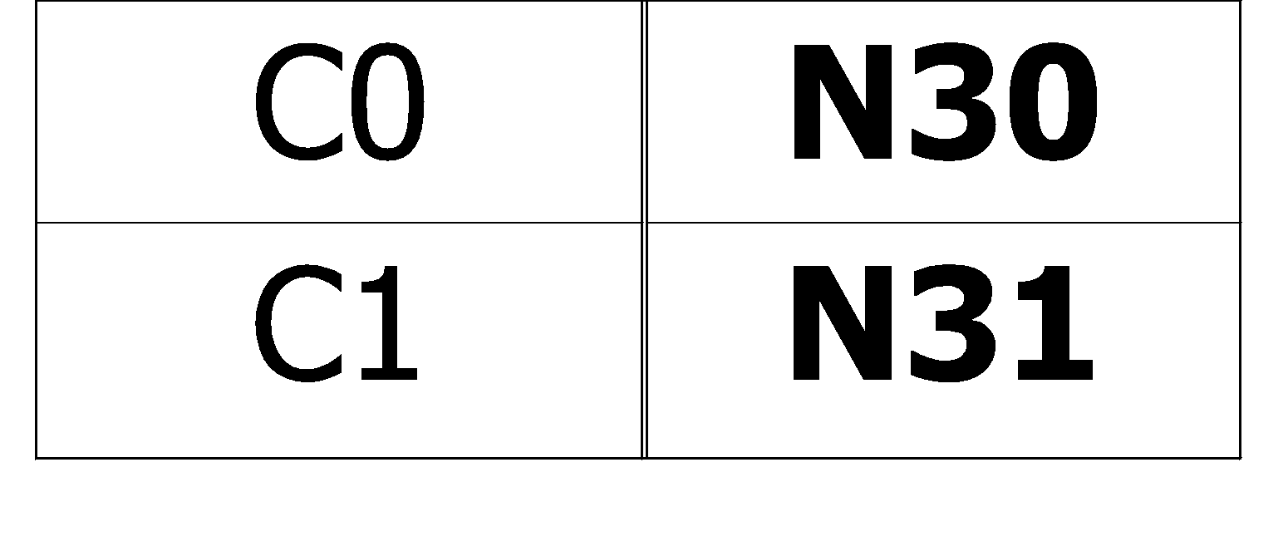
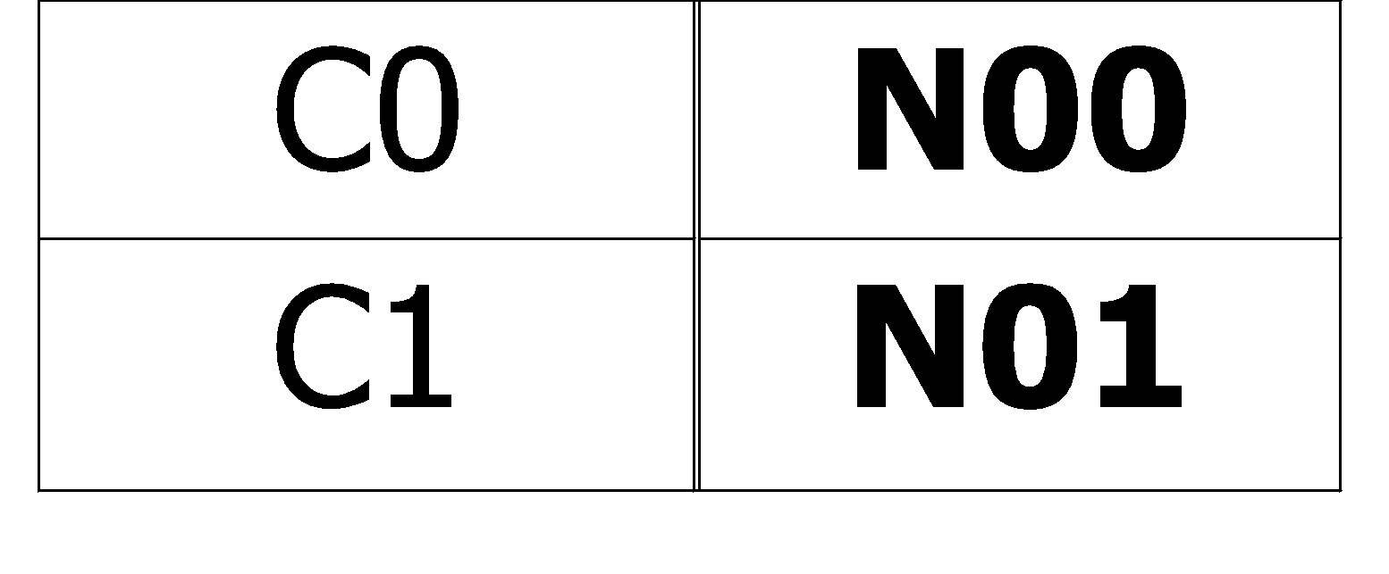
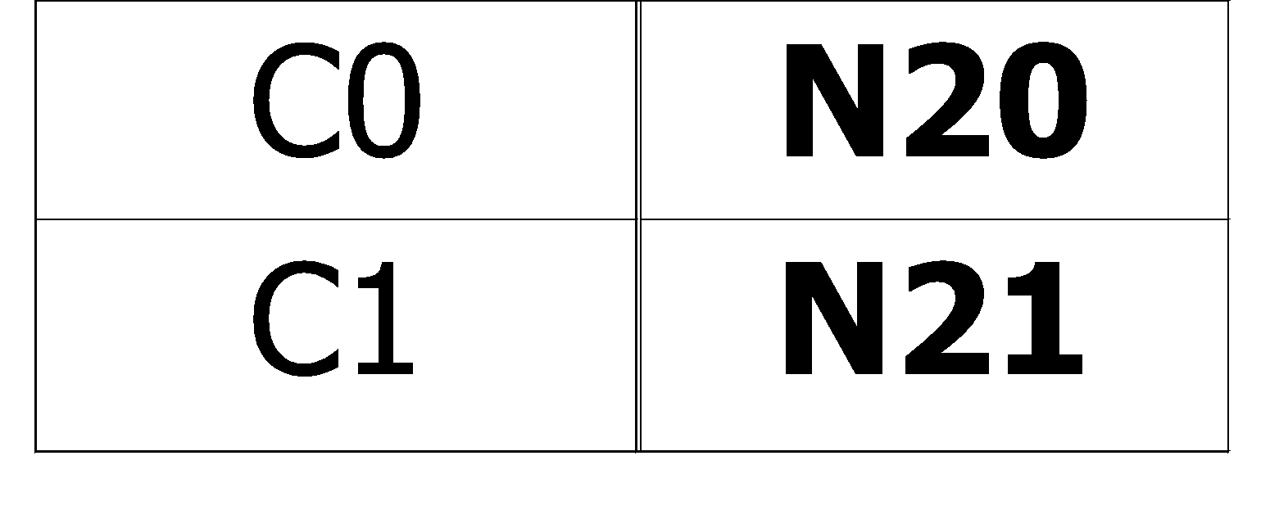
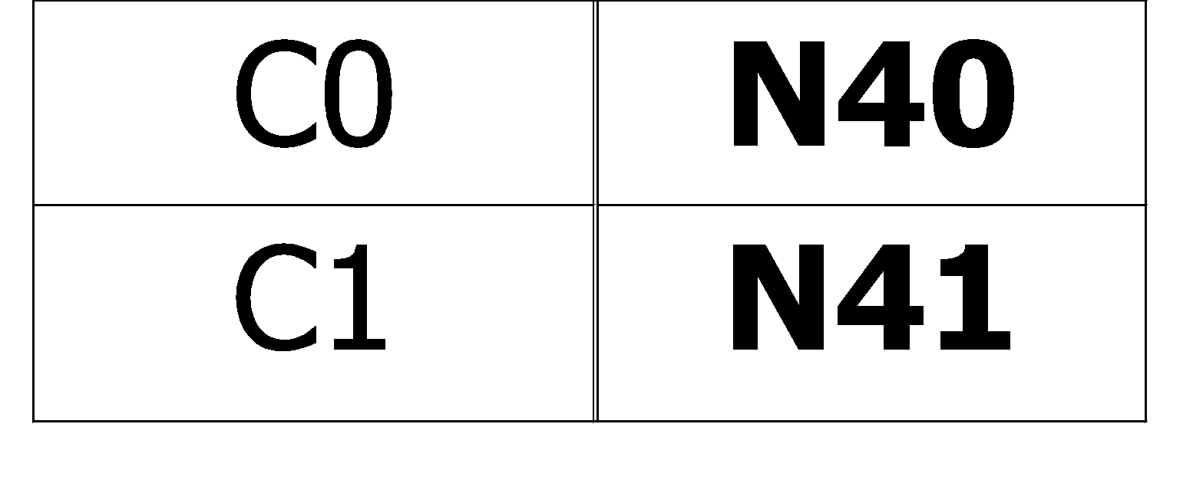
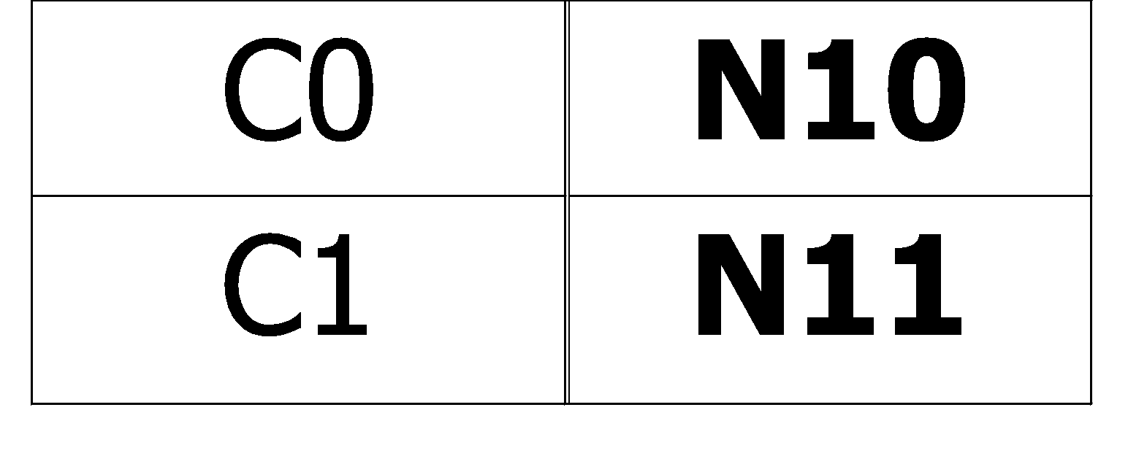
Finding the Best Split
Before Splitting:
P
A?
B?
Yes
No
Yes
No
Node N1
Node N2
Node N3
Node N4
M11
M12
M21
M22
M1
M2
Gain = P – M1 vs P – M2

Slide 31
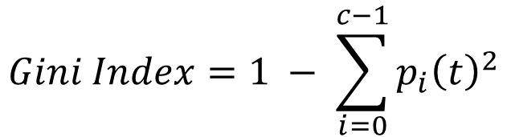
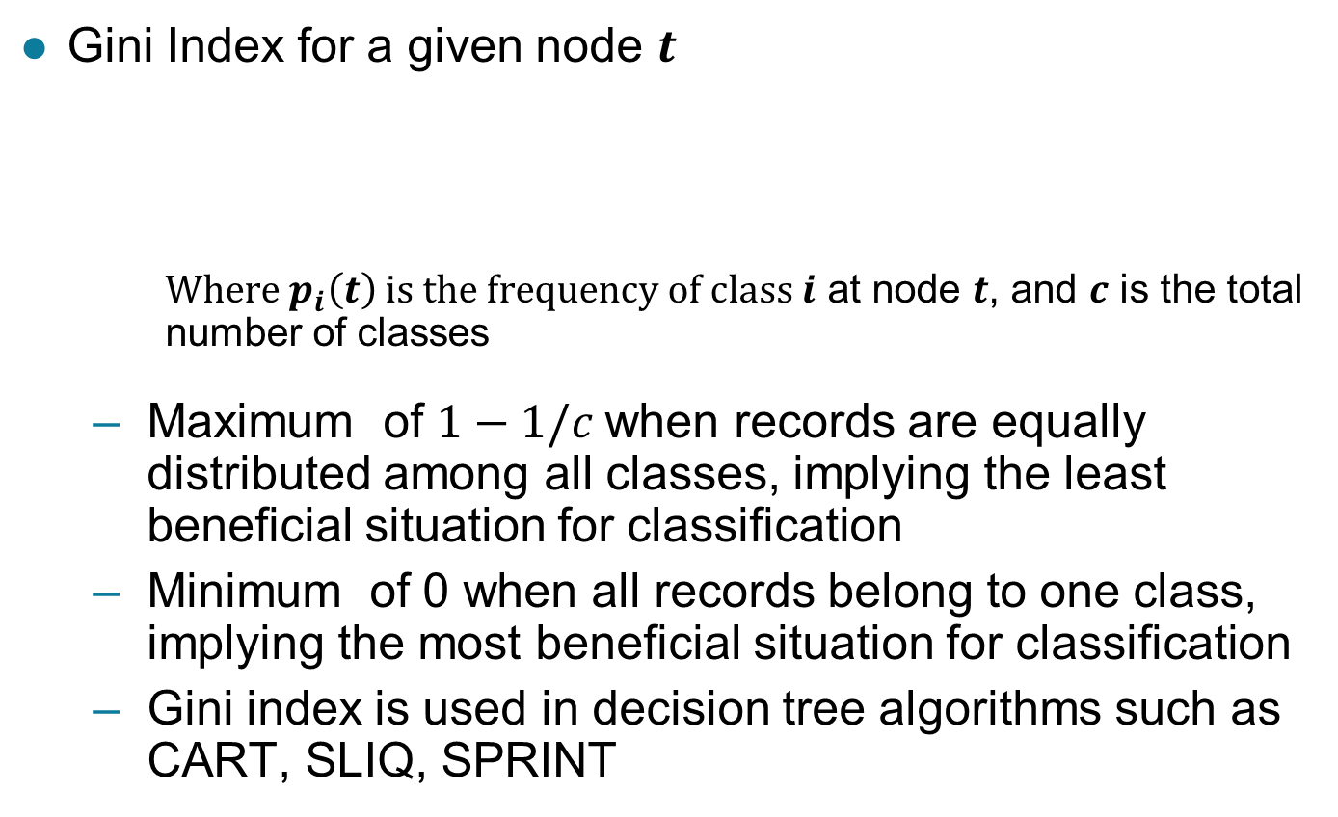
Measure of Impurity: GINI

Slide 32
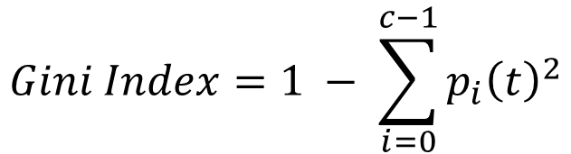
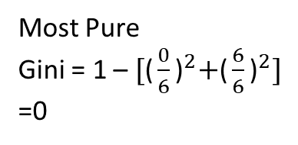

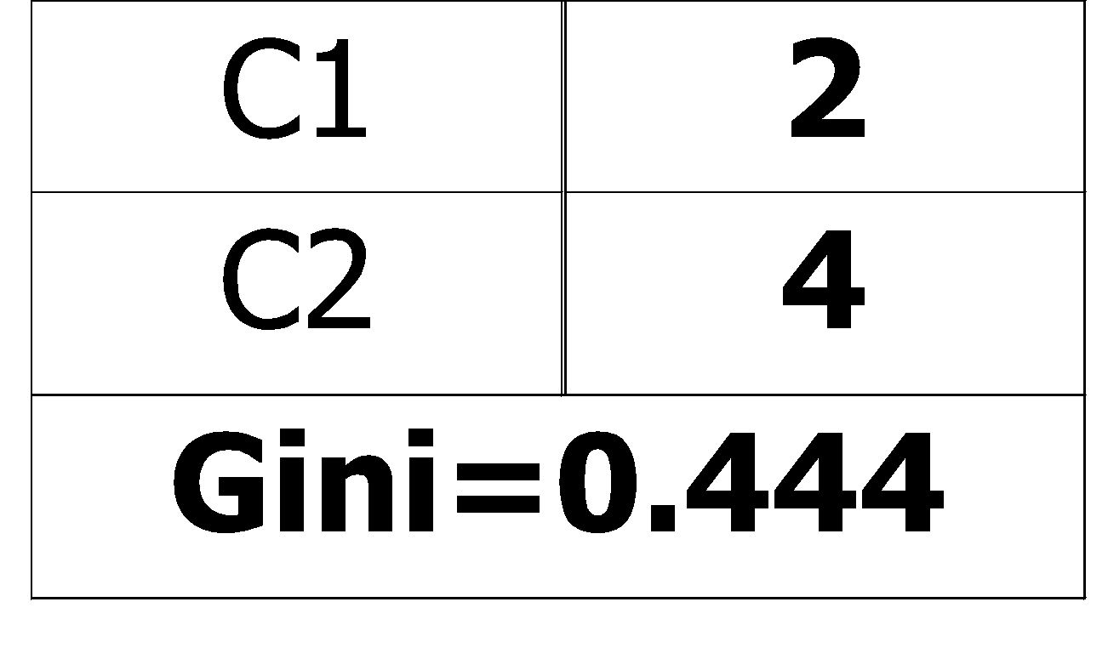
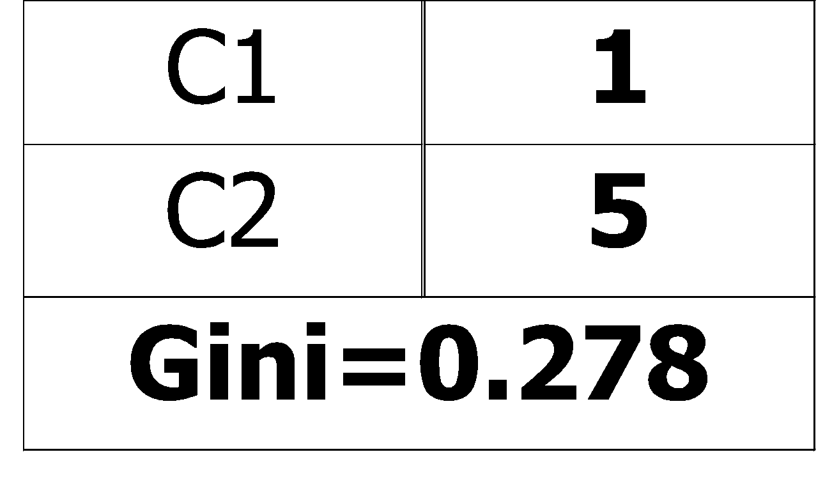
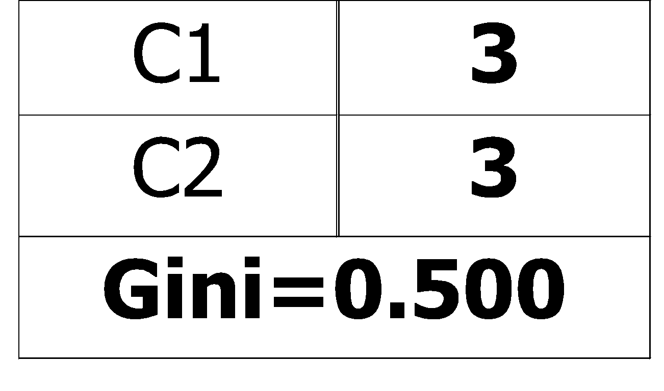
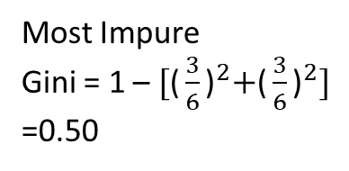
Measure of Impurity: GINI
Gini Index for a given node t :
For 2-class problem (p, 1 – p):
GINI = 1 – p² – (1 – p)² = 2p (1-p)
Impurity $∝Gini$
Most Pure
Gini = 1 – ${\text{[}\text{(}\frac{0}{6}\text{)}}^{2}+{\text{(}\frac{6}{6}\text{)}}^{2}]$
=0
Most Impure
Gini = 1 – ${\text{[}\text{(}\frac{3}{6}\text{)}}^{2}+{\text{(}\frac{3}{6}\text{)}}^{2}]$
=0.50

Slide 33
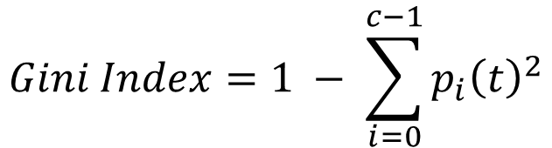
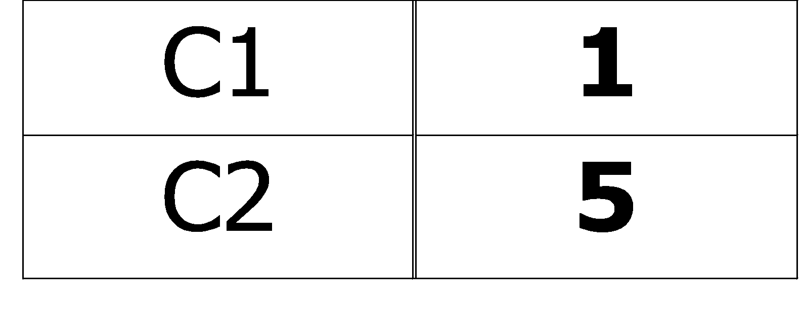
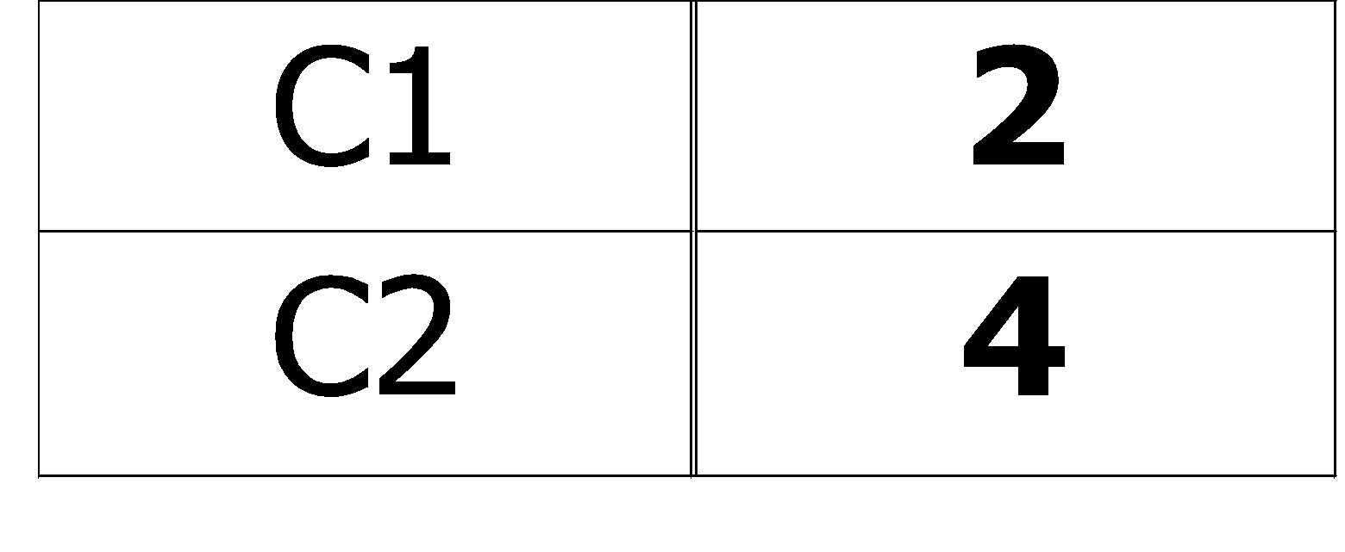
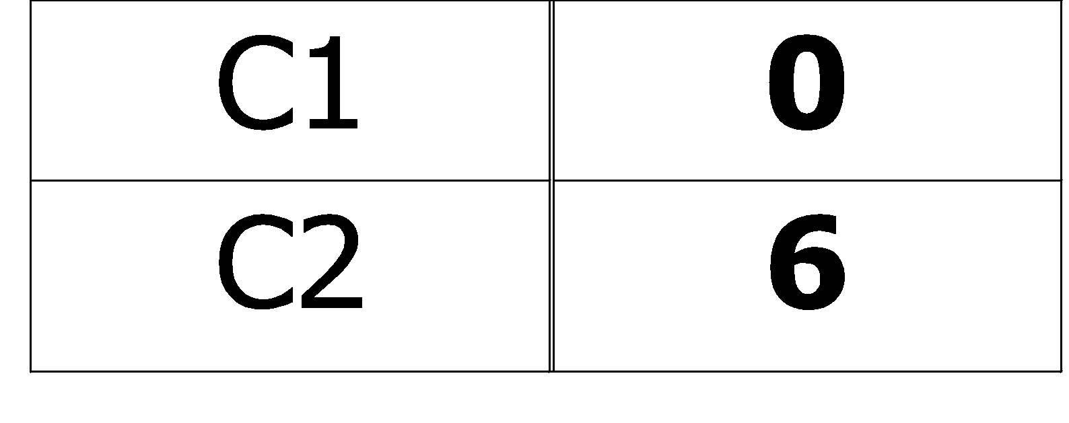
Computing Gini Index of a Single Node
P(C1) = 0/6 = 0 P(C2) = 6/6 = 1
Gini = 1 – P(C1)² – P(C2)² = 1 – 0 – 1 = 0
P(C1) = 1/6 P(C2) = 5/6
Gini = 1 – (1/6)² – (5/6)² = 0.278
P(C1) = 2/6 P(C2) = 4/6
Gini = 1 – (2/6)² – (4/6)² = 0.444

Slide 34
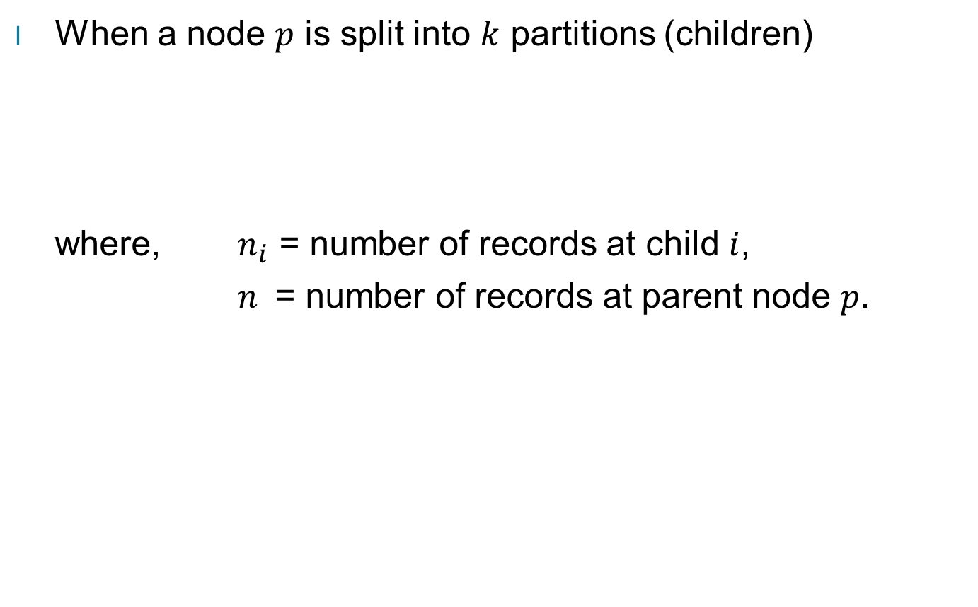
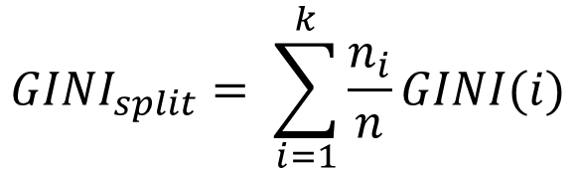
Computing Gini Index for a Collection of Nodes

Slide 35
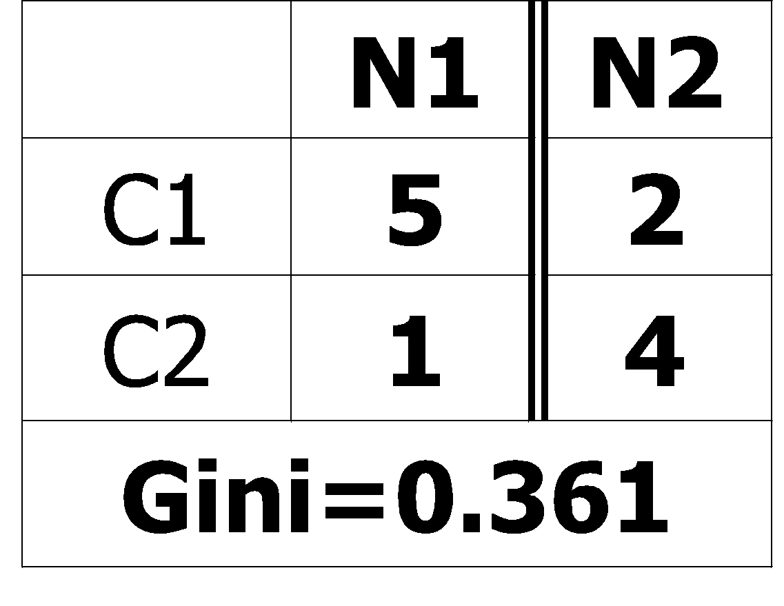
Binary Attributes: Computing GINI Index
Splits into two partitions (child nodes)
Effect of Weighing partitions:
Larger and purer partitions are sought
Before Splitting
B?
Yes
No
Node N1
Node N2
Gini(N1) = 1 – (5/6)² – (1/6)² = 0.278
Gini(N2) = 1 – (2/6)² – (4/6)² = 0.444
Weighted Gini of N1 and N2 = 6/12 * 0.278 + 6/12 * 0.444 = 0.361
Gain = 0.486 – 0.361 = 0.125
After Splitting

Slide 36
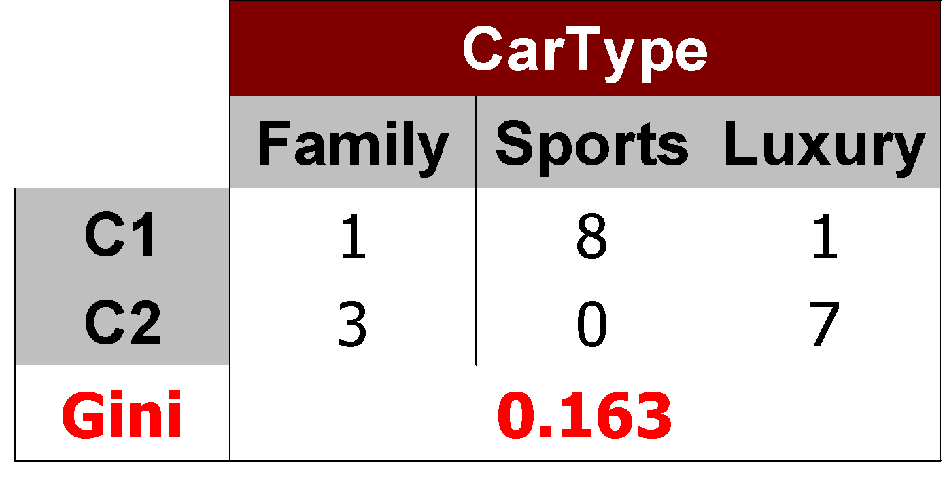
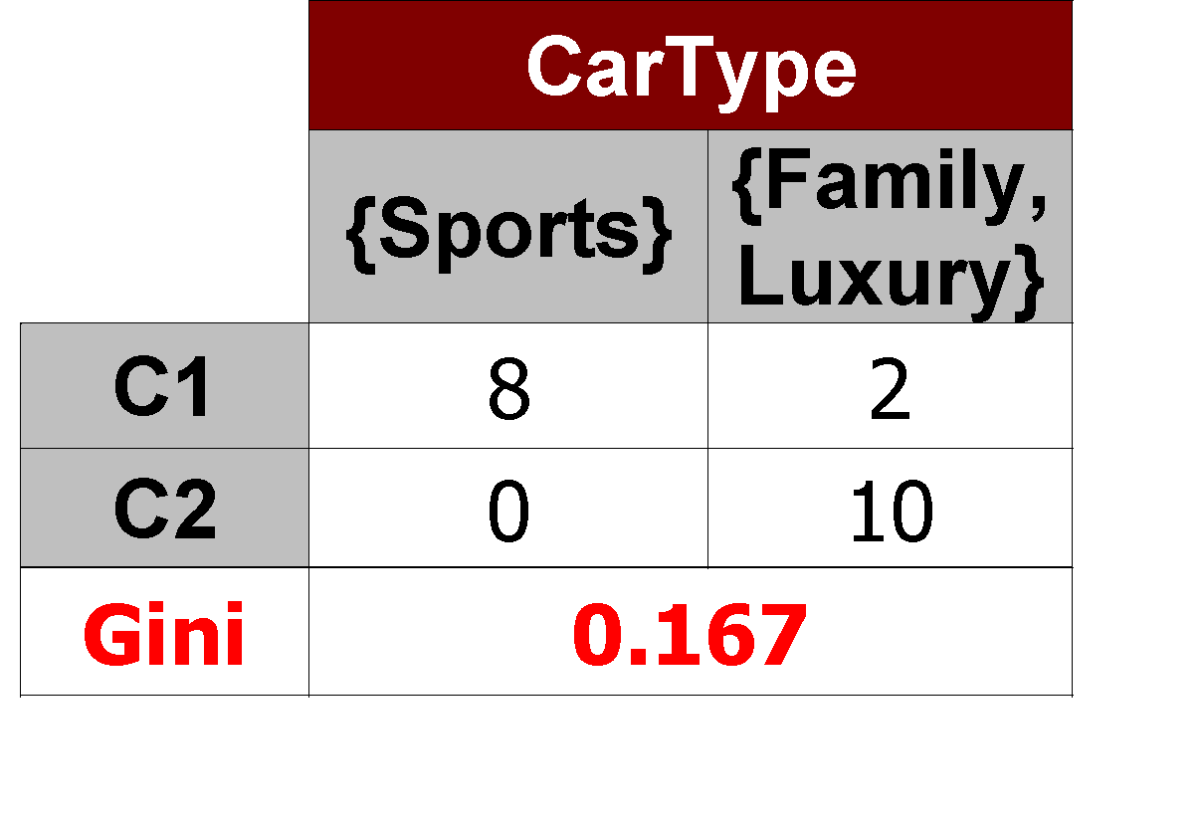
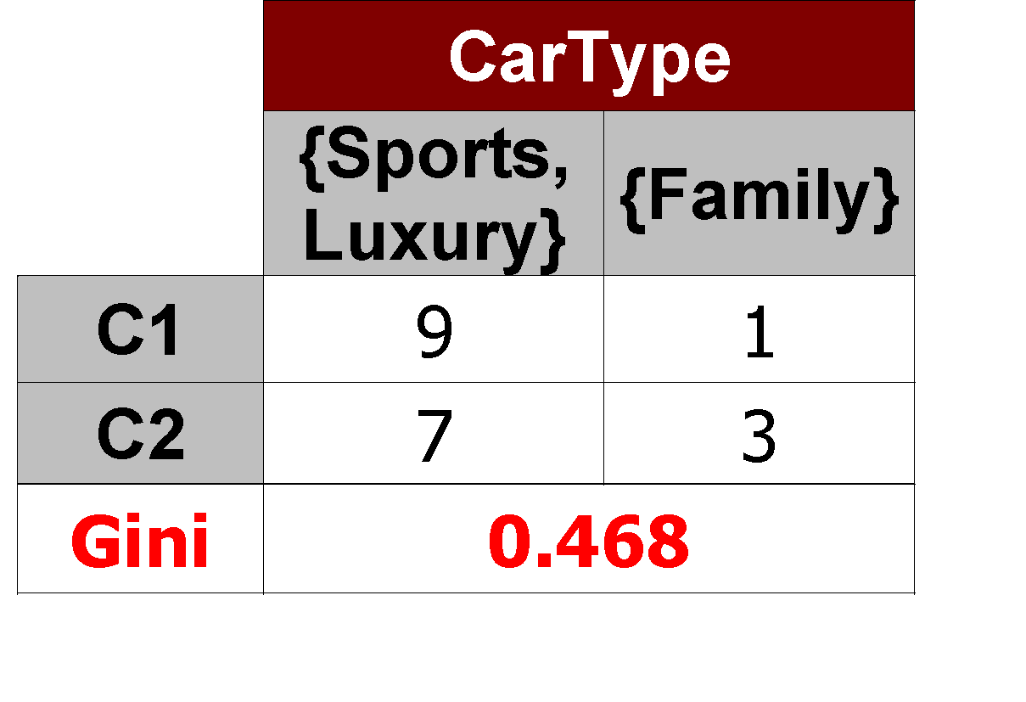
Categorical Attributes: Computing Gini Index
For each distinct value, gather counts for each class in the dataset
Use the count matrix to make decisions
Multi-way split
Two-way split
(find best partition of values)
Which of these is the best?

Slide 37
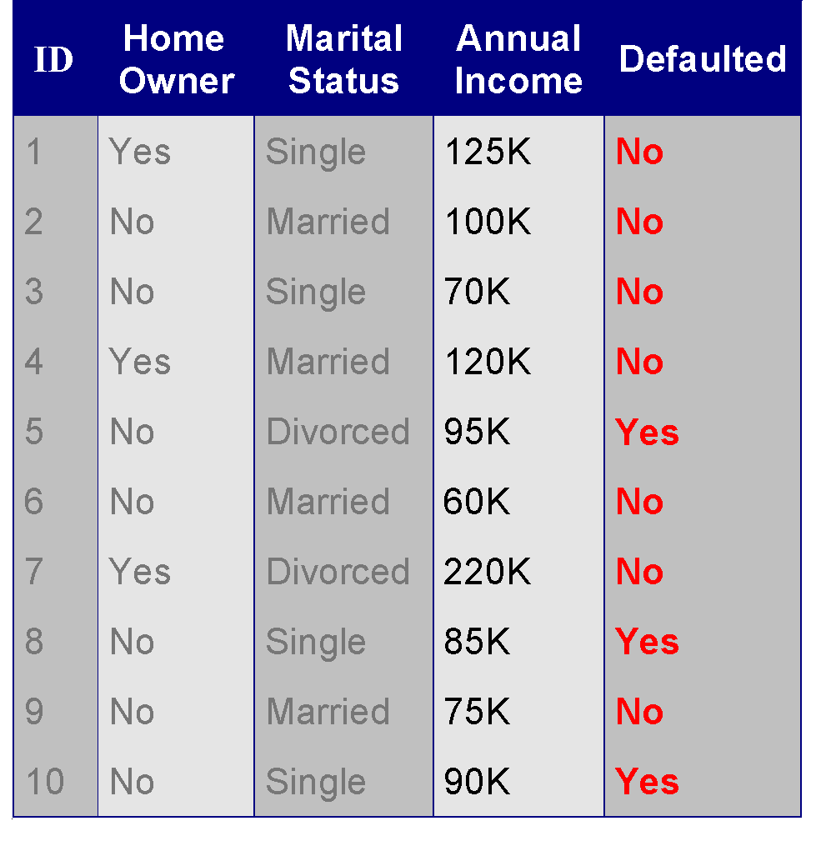
Continuous Attributes: Computing Gini Index
Use Binary Decisions based on one value
Several Choices for the splitting value
Number of possible splitting values = Number of distinct values
Each splitting value has a count matrix associated with it
Class counts in each of the partitions, A ≤ v and A > v
Simple method to choose best v
For each v, scan the database to gather count matrix and compute its Gini index
Computationally Inefficient! Repetition of work.
Annual Income ?
 | ≤ 80 | > 80
Defaulted Yes | 0 | 3
Defaulted No | 3 | 4

Slide 38
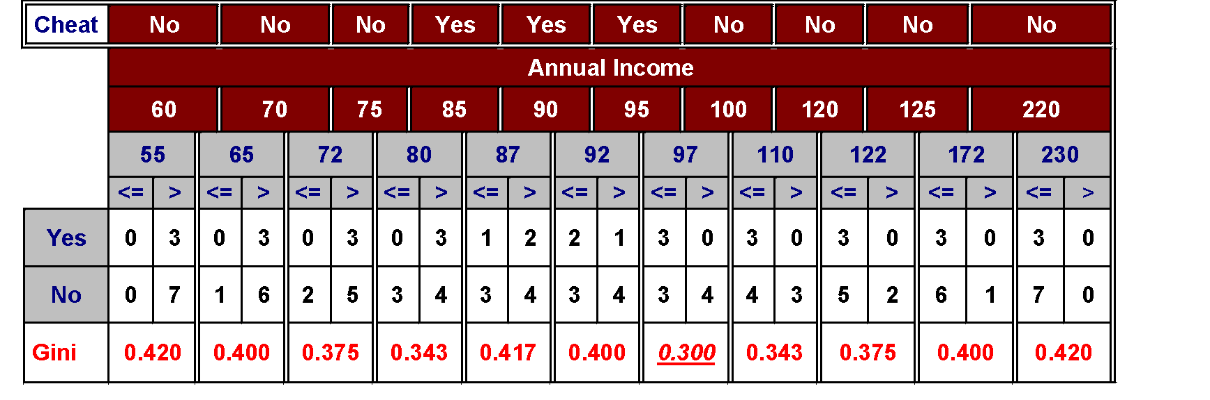
Continuous Attributes: Computing Gini Index...
For efficient computation: for each attribute,
Sort the attribute on values
Linearly scan these values, each time updating the count matrix and computing gini index
Choose the split position that has the least gini index
Sorted Values

Slide 39
Continuous Attributes: Computing Gini Index...
For efficient computation: for each attribute,
Sort the attribute on values
Linearly scan these values, each time updating the count matrix and computing gini index
Choose the split position that has the least gini index
Sorted Values
Split Positions

Slide 40
Continuous Attributes: Computing Gini Index...
For efficient computation: for each attribute,
Sort the attribute on values
Linearly scan these values, each time updating the count matrix and computing gini index
Choose the split position that has the least gini index
Sorted Values
Split Positions

Slide 41
Continuous Attributes: Computing Gini Index...
For efficient computation: for each attribute,
Sort the attribute on values
Linearly scan these values, each time updating the count matrix and computing gini index
Choose the split position that has the least gini index
Sorted Values
Split Positions

Slide 42
Continuous Attributes: Computing Gini Index...
For efficient computation: for each attribute,
Sort the attribute on values
Linearly scan these values, each time updating the count matrix and computing gini index
Choose the split position that has the least gini index
Sorted Values
Split Positions

Slide 43
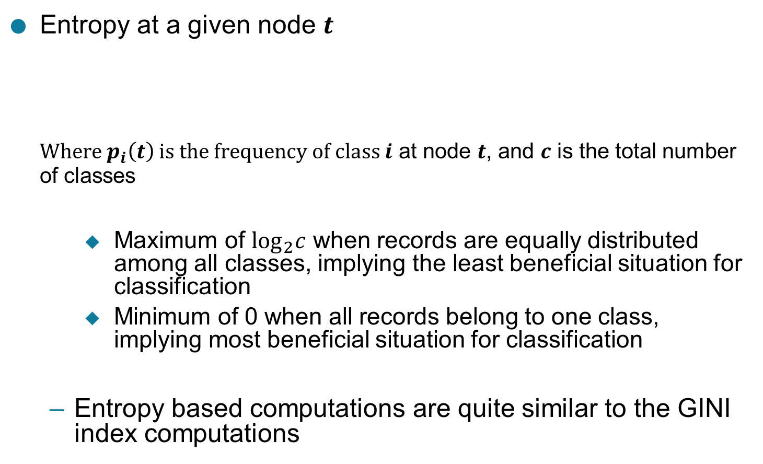

Measure of Impurity: Entropy

Slide 44

Computing Entropy of a Single Node
P(C1) = 0/6 = 0 P(C2) = 6/6 = 1
Entropy = – 0 log 0 – 1 log 1 = – 0 – 0 = 0
P(C1) = 1/6 P(C2) = 5/6
Entropy = – (1/6) log₂ (1/6) – (5/6) log₂ (5/6) = 0.65
P(C1) = 2/6 P(C2) = 4/6
Entropy = – (2/6) log₂ (2/6) – (4/6) log₂ (4/6) = 0.92

Slide 45


Computing Information Gain After Splitting

Slide 46



Gain Ratio: Gain Ratio attempts to lessen the bias of Information Gain on highly branched predictors by introducing a normalizing term called the Split Info
Penalize the number of splits/partitions
# of splits $↑;$ S$plit info↑$ G$ain Ratio↓$

Slide 47


Gain Ratio
SplitINFO = 1.52
SplitINFO = 0.72
SplitINFO = 0.97

Slide 48


Measure of Impurity: Classification Error

Slide 49

Computing Error of a Single Node
P(C1) = 0/6 = 0 P(C2) = 6/6 = 1
Error = 1 – max (0, 1) = 1 – 1 = 0
P(C1) = 1/6 P(C2) = 5/6
Error = 1 – max (1/6, 5/6) = 1 – 5/6 = 1/6
P(C1) = 2/6 P(C2) = 4/6
Error = 1 – max (2/6, 4/6) = 1 – 4/6 = 1/3

Slide 50

Comparison among Impurity Measures
For a 2-class problem: Binary Classification

Slide 51


Misclassification Error vs Gini Index
A?
Yes
No
Node N1
Node N2
Gini(N1) = 1 – (3/3)² – (0/3)² = 0
Gini(N2) = 1 – (4/7)² – (3/7)² = 0.489
Gini(Children) = 3/10 * 0 + 7/10 * 0.489 = 0.342
Gini improves but error remains the same!!

Slide 52

Misclassification Error vs Gini Index
A?
Yes
No
Node N1
Node N2
Misclassification error for all three cases = 0.3 !

Slide 53
Decision Tree Based Classification
Advantages:
Relatively inexpensive to construct
Extremely fast at classifying unknown records
Easy to interpret for small-sized trees
Robust to noise (especially when methods to avoid overfitting are employed)
Can easily handle redundant attributes
Can easily handle irrelevant attributes (unless the attributes are interacting)
Disadvantages: .
Due to the greedy nature of splitting criterion, interacting attributes (that can distinguish between classes together but not individually) may be passed over in favor of other attributed that are less discriminating.
Each decision boundary involves only a single attribute

